Slide 1

Airbnb Nightly Rate Recommendation Modeling
William Justice
Bellevue University
7/5/2021

Slide 2
Problem Overview
Company Problem
Data Science Solution
Hosts often do not know exactly how much to reasonably charge for a nightly rate.
Create a model that has the ability to update/recommend nightly rates to existing and new hosts that takes into account other similar stays in the area, amenities, as well as user reviews.

Slide 3
ROI Potential
Host Service Fee
Hosts pay a 3% fee of the nightly rate
By providing the host with the most competitive rate for their accommodation, the organization can assure that the host will not over or under price their stay.
Thus, the model will provide/recommend an optimized the nightly rate, helping the host to not “self-optimize” through trial and error, increasing customer price-point satisfaction.

Slide 4
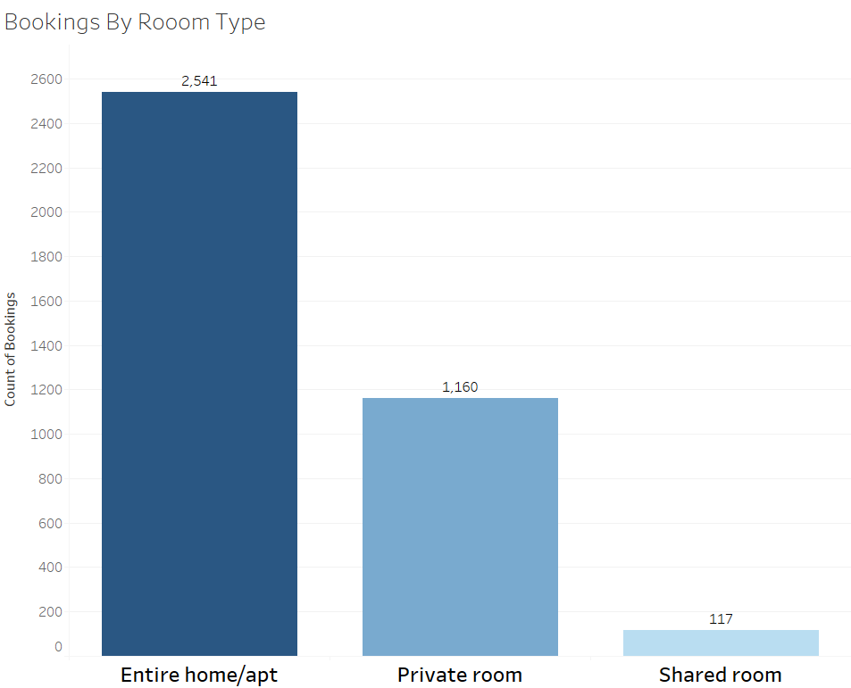
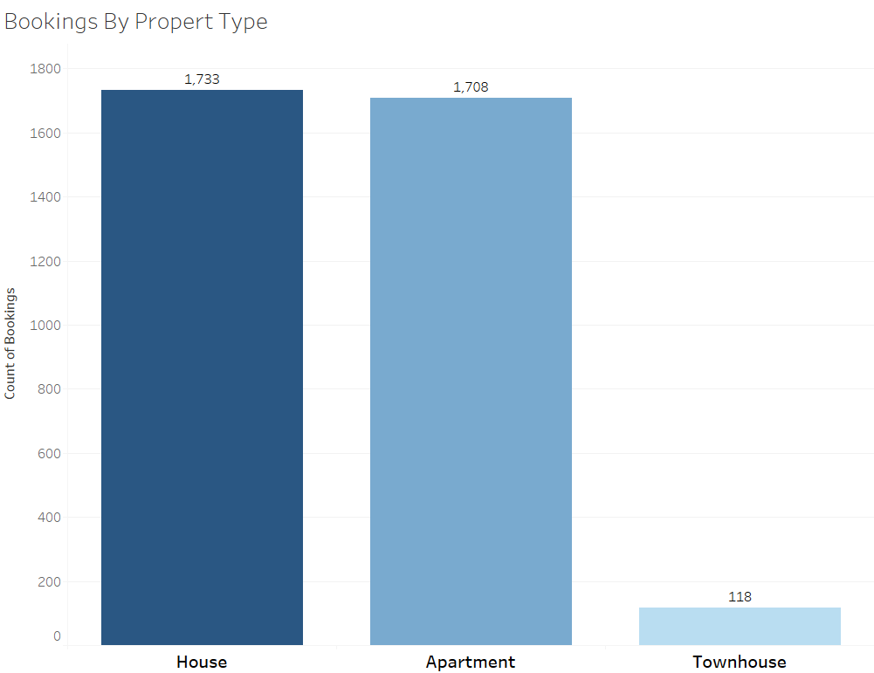
Most Popular Bookings
It appears that Entire homes/apartments are in much higher demand compared to other type of accommodations such as a private or shared room.
Although this is expected it is certainly valuable information for feature reduction purposes.
* Only top 3 property types displayed.

Slide 5
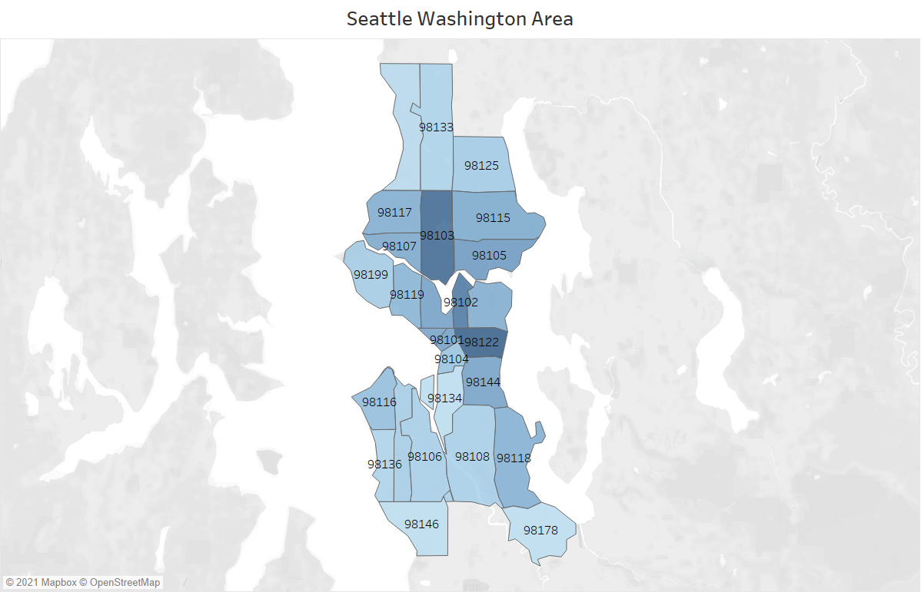
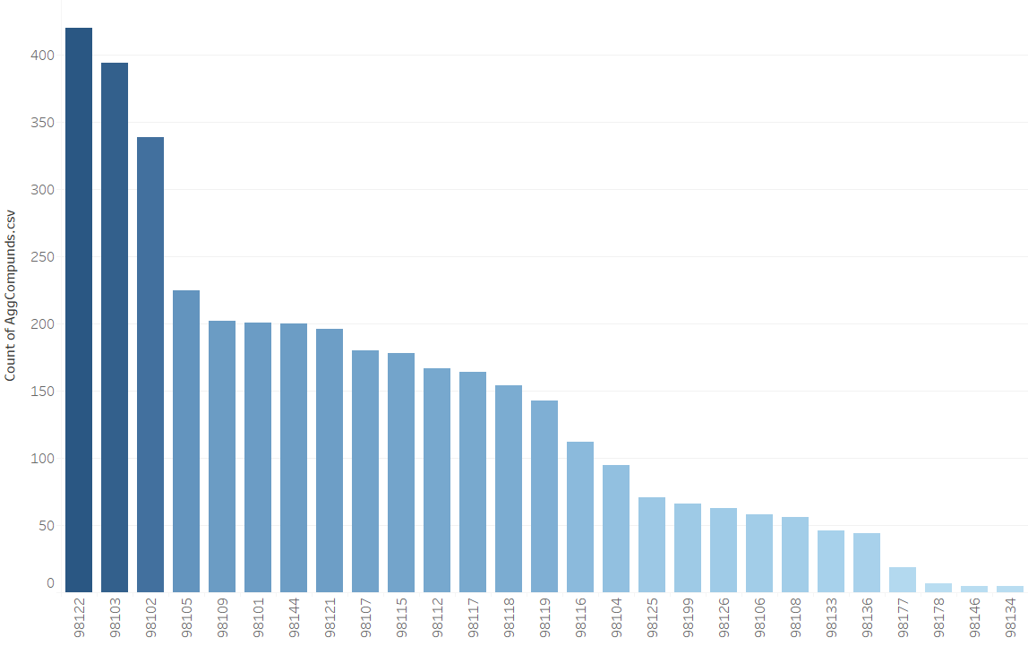
Popular Bookings By Locations
These areas may have the best ROI capability based on the popularity of bookings.

Slide 6
Feature Engineering
NLTK Vader Sentiment Analysis
Engineered two features based on (1) customer feedback comments and (2) Host booking description.
The NLTK VADER sentiment analysis apples a score from negative 1 to positive one. Positive one being the most positive and negative one being the most negative.
The sentiment analysis appeared to work well for host scoring but under achieved for customer feedback.
May this be due to customers not being critical enough of the accommodation? Other reasons?
Either way this sentiment analysis requires increased sensitivity functions.

Slide 7
Feature Reduction with ANOVA Testing
Feature | PValue
Bathrooms | 0.00
Room Type | 0.00
Bedrooms | 0.00
Cleaning Fee | 0.00
Accommodates | 0.00
Reviews Per Month | 0.00025
Review Scores Checkin | 0.00137
Guests Included | 0.00271
Review Scores Rating | 0.00485
Zipcode | 0.01439
Review Scores Value | 0.01568
Neighborhood Group | 0.02316
Property Type | 0.02613
Host Response Time | 0.030
Host Compound Score (Sentiment) | 0.1672
Customer Compound Score (Sentiment) | 0.7

Slide 8
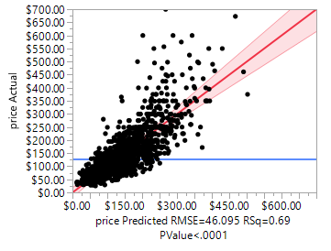
Linear Regression Modeling
● RMSE of $46. Seems Relatively high for a recommendation tool with the largest range of nightly average falling around the $100 mark.
● R squared is also somewhat low for acceptance.
● Likely not valid for deployment to customers.

Slide 9
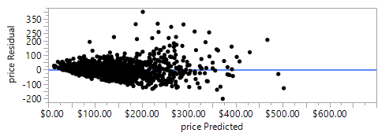
Linear Regression Residuals
•As we can see the Residuals Plot shows that the model is best within only a very strict range of price points. About the $50- $300.

Slide 10
Neural Network Modeling
The NN model performed better than the regression model.
The R squared value is just over an acceptable rate.
The RMSE is still too high.
Although this model performs better of the two it is possible for deployment.
Metric | Training | Validation
R Squared | 0.819 | 0.805
RMSE | 34.47 | 33.59
Mean Abs Dev | 23.90 | 24.27
Validation = KFold (10 Folds)
Random Seed = 7
Hidden Nodes = 13

Slide 11
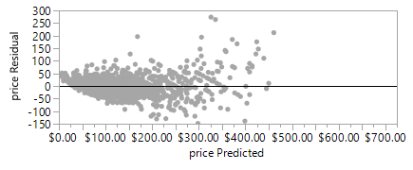
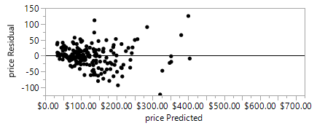
Neural Network Residuals
Training
The residuals of the NN are slightly closer than that of the regression model.
Interesting insight here is that the nn will not attempt to inaccurately predict prices over the ~$325 point. Which is where performance decline in the regression model.
Predicted

Slide 12
Findings & Reccomendations
Modeling for this business problem shows great potential for significant ROI.
Current modeling shows that deployment is possible if agreed upon the ~$34 error potential.
The Data Science department requests additional data be gathered after customer stays in order to assess the quality of the accommodation….

Slide 13
Findings & Reccomendations Continued
3.1 It is diffuclt for the model to asses the quality of the accomodation in terms of furnishings and overall updates. For example, the current data offers no collection for updatedness of the booking. A simple 1-10 question may be able to solve this problem.
4. The Data Scince Team would like to achieve ~$20 RMSE value before deployment.

